Slide 1
CSC-803 Final Point-of-Sale Malware Techniques and Abusing an Insecure Thermal Printer
Micah Flack

Slide 2
Introduction - Topics
How common the POS malware industry is
Types of serial debug ports
JTAG / UART
Locate layouts
Identify board components
How to interface with devices
Demonstrate an insecure thermal printer commonly used by POS systems

Slide 3
Point-of-Sale (POS) Malware Statistics
Retail businesses have become increasingly reliant on digital transactions since the creation of the point-of-sale (POS) system by IBM in 1973.
And with that adoption of a new digital transaction system, came new types of crime as well:
During the 19 months between February 2021 and September 2022, there were 167,000 stolen payment records because of two POS malware operators using existing RAM scraping malware.

Slide 4
What are Serial Debug Access Ports (DAP)?
A debug access port (DAP) is a chip-level diagnostic interface tool used to directly communicate with the CPU or microcontroller.
With the correct hardware, an operator can use a debugger like GDB to halt the chip and manually troubleshoot any code running on it.
In some instances, if the debugged device were running something like RTOS (a lightweight embedded OS) they could debug the firmware running directly on the processor within Eclipse development tools.

Slide 5
Serial DAP
Typically, to interface with any serial DAP, we to least identify:
TDO/RX: trace used for receiving instructions
TDI/TX: trace used for transmitting instructions
VCC: either to supply power or reference board voltage
Commonly either 3.3V or 5V
GND: any trace used for ground
Each format is different and you to verify before interfacing.
Common formats are:
JTAG/UART/SWD/OBD/CANBUS

Slide 6
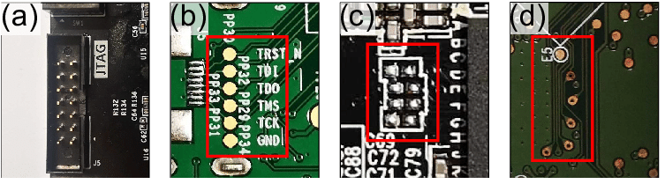
JTAG Layout Examples

Slide 7
Identifying DAP Interfaces
In the previous slide we showed examples of different JTAG layouts. However, there might be some instances where the ports are unlabeled or mismatching.
One method we can use is to consult the chipset manufacturer datasheet.
With the manual we can identify pinouts on the chip and then use the continuity function of a multimeter map the chip pins to groups of unlabeled traces.

Slide 8
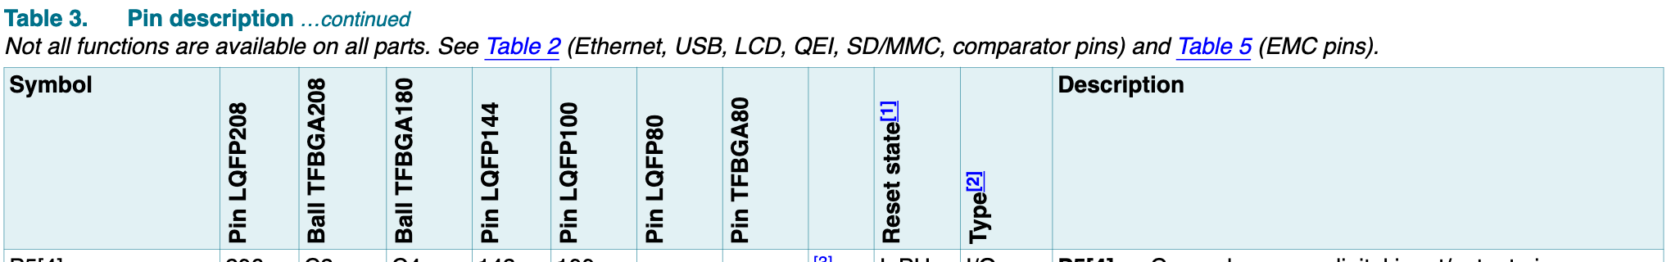
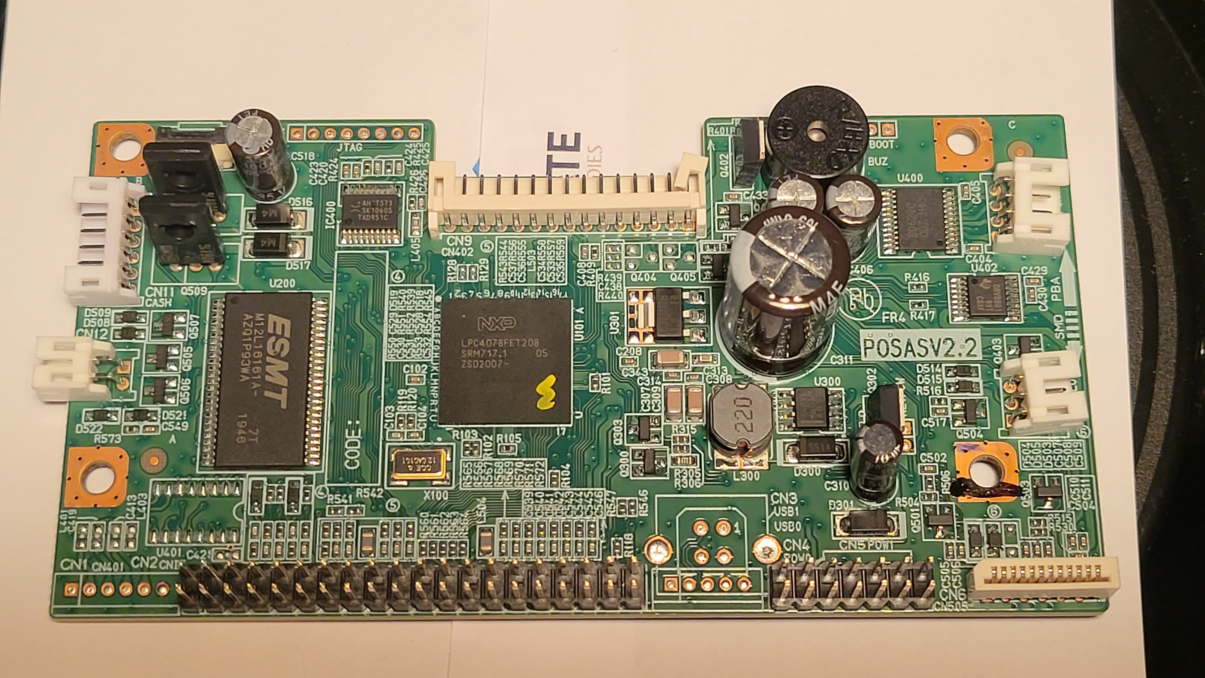
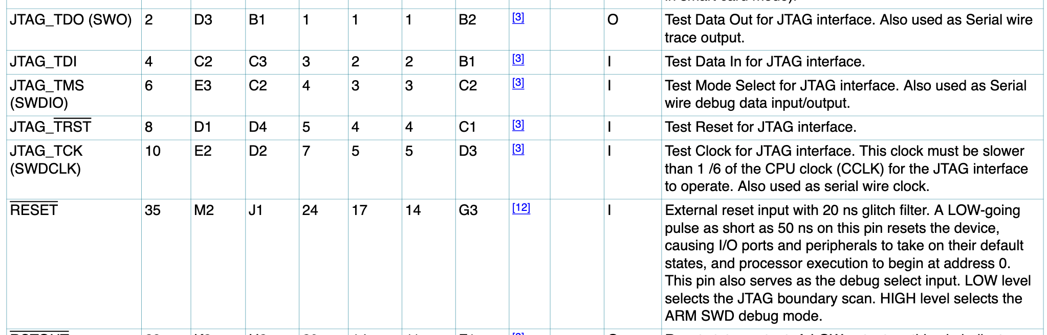
Chipset Identification (Config TFBGA208)
For example, if the we look at this image…. We can identify that the chipset serial number is LPC4078FET208 from NXP.
The datasheet for the chip then shows us the corresponding pin numbers:

Slide 9
Connecting and Mapping JTAG PINS
Connecting to the interface is relatively simple, we just needed to create a wire harness that our debugger can use. From left to right, the pins and wires used to connect are:
Black – GRND – Pin B4
Purple – TDO – Pin B1
White – TDI – Pin C3
Green – TMS – Pin C2
Orange – TCK – Pin D2
Brown – TRST – Pin D4
Yellow – VDD – Pin E2

Slide 10
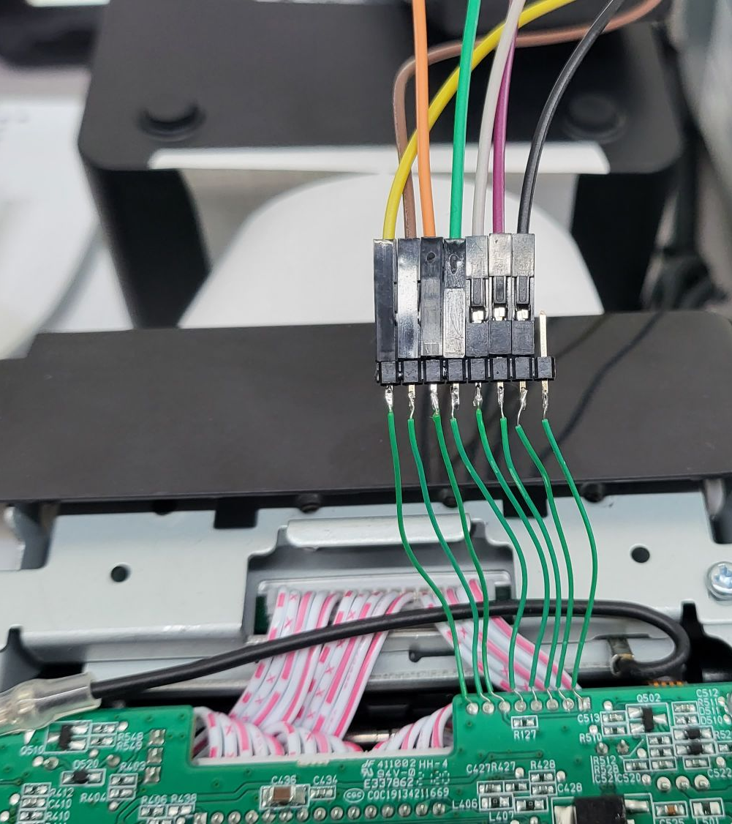
Attached JTAG Harness
Color coding the harness is especially helpful for keeping track of which wire is used for what pin of the JTAG port.
WARNING: If you mismatch the GND or VCC with any other JTAG pin, it will cause irreversible damage.

Slide 11
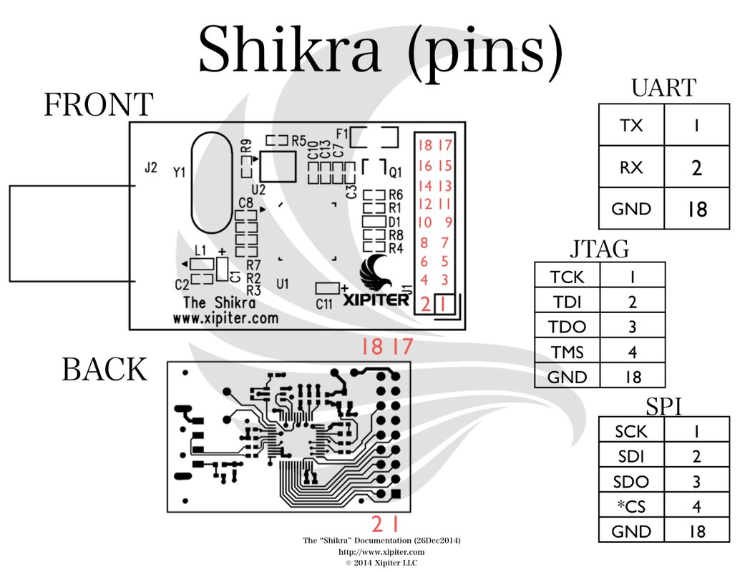
Using Serial debugger devices
Shikra (or whatever alternative) should be wired to the target device before connecting to computer.
Once connected, you should see the following devices appear:
Windows
Device Manager > Ports (COM & LPT)
Should see something like “COM1”
Linux
sudo dmesg | grep ttyUSB0
Should see some output showing the device was connected and registered to ttyUSB#

Slide 12
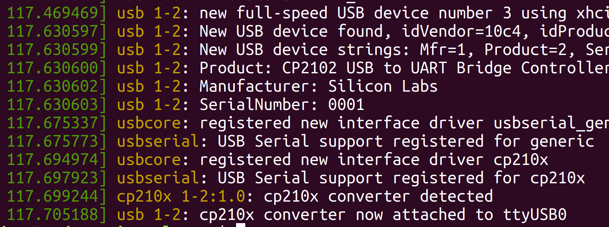
Debugger Device Connection

Slide 13
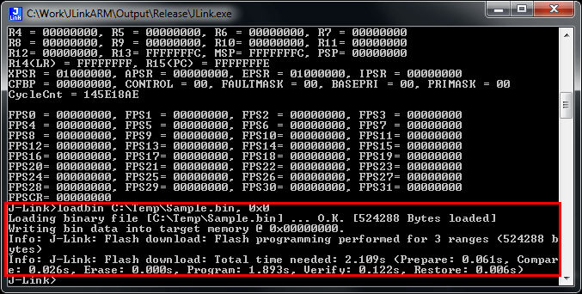
Unrestricted Memory Scraping

Slide 14
Conclusion
The presentation simply demonstrates that POS malware is a common occurrence within the finance/retail industry, and the devices that POS systems use can be easily compromised.
Looking at the previous slide, if a malicious operator had the opportunity, they could flash their own RTOS image onto the printer. This would allows them to emulate HID inputs, use the Bluetooth or network stack for data exfiltration, or whatever they’re able to develop because RTOS is opensource.
This is why securing physical I/O within the bootloader or locking flags within the processor is important.

